Slide 1
Analytics Challenge
Alfredo Quintero
10 Feb 2025

Slide 2
Agenda
01
Data explore preparation & normalization
02
Trend Analysis & Forecasting
Applied statistical techniques like linear regression to compute trend lines for key metrics (xgt, target, bar, wsg, juu), enabling clear visualization of trends over time.
Ensured data integrity by converting date fields to the correct format (MM/DD/YYYY), normalizing key variables using MinMaxScaler, and handling missing or incorrect values.
SQL & Synapse Analytics
03
Power bi integration
04
Created serveless tables in Azure Synapse Analytics for the computed models, optimizing performance, and ensuring smooth querying for reporting.
Transformed data into a structured Parquet format for seamless import into Power BI, ensuring compatibility with date fields and enabling efficient time-series analysis.
.

Slide 3
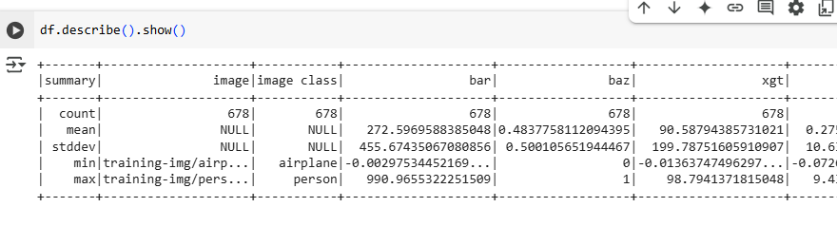
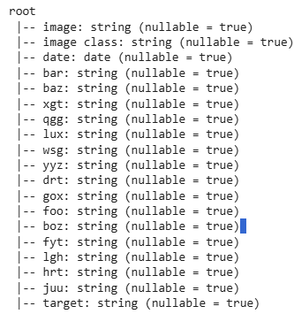
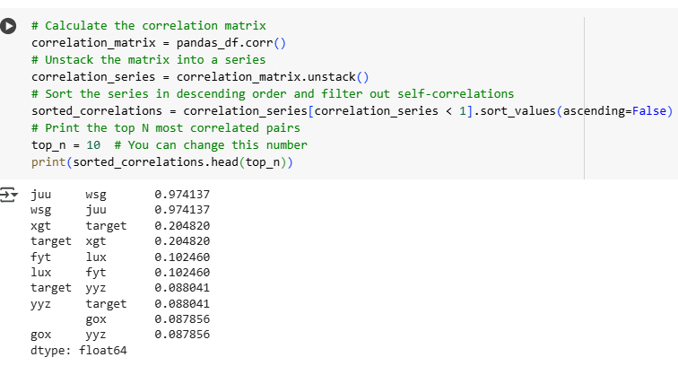
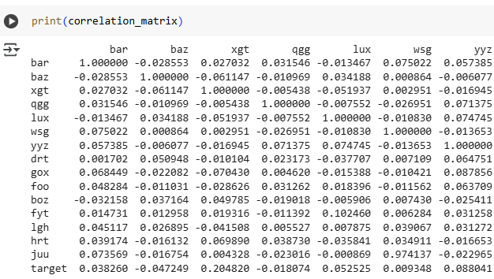
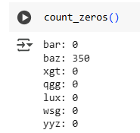
Data Explore

Slide 4
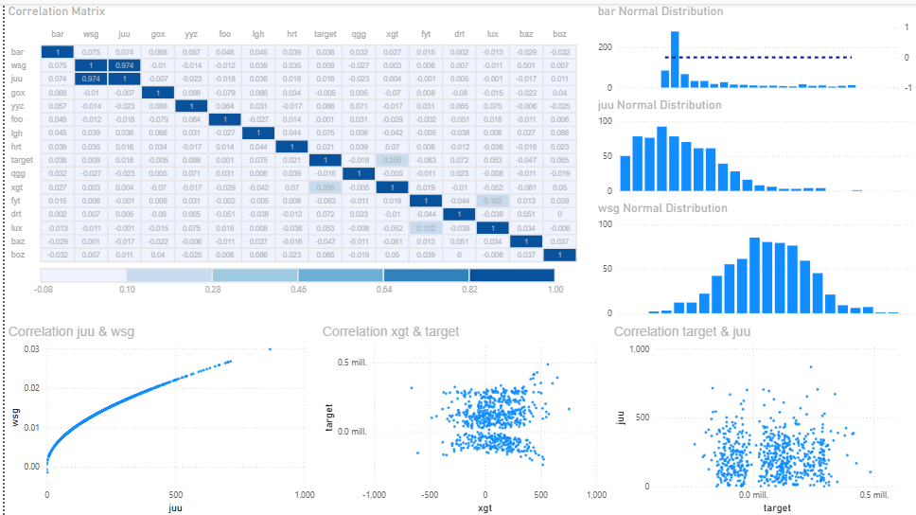
Correlation

Slide 5
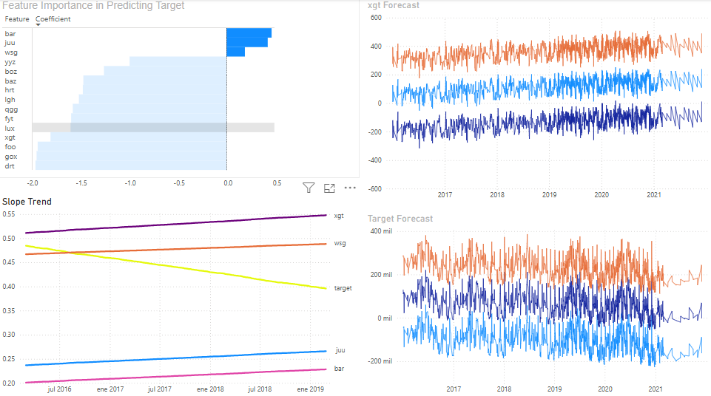
Trends &Time Series Forecasting

Slide 6
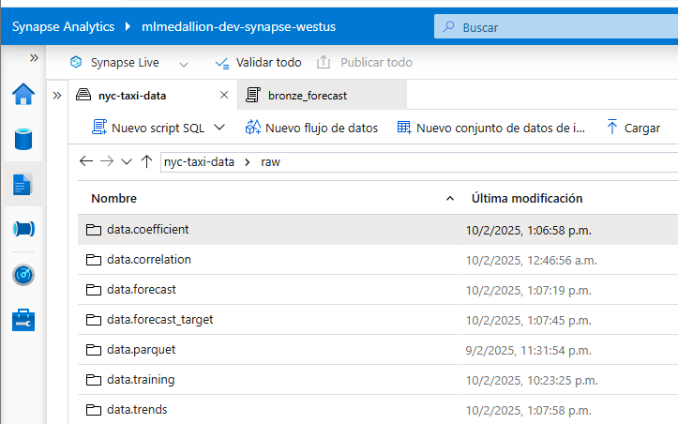
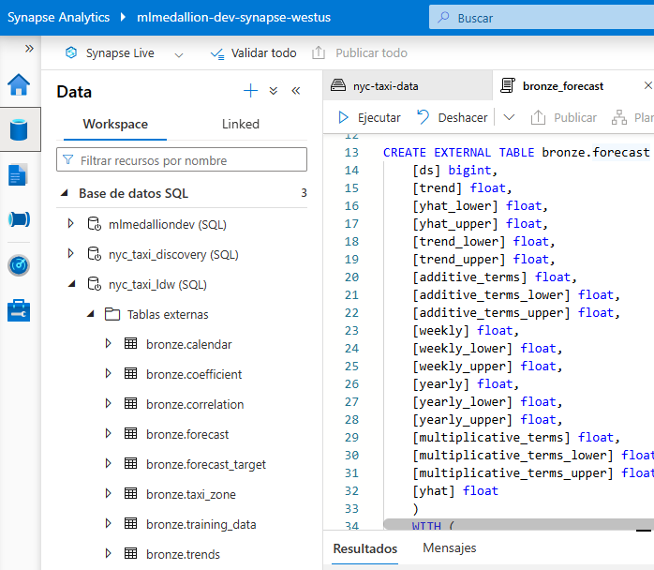
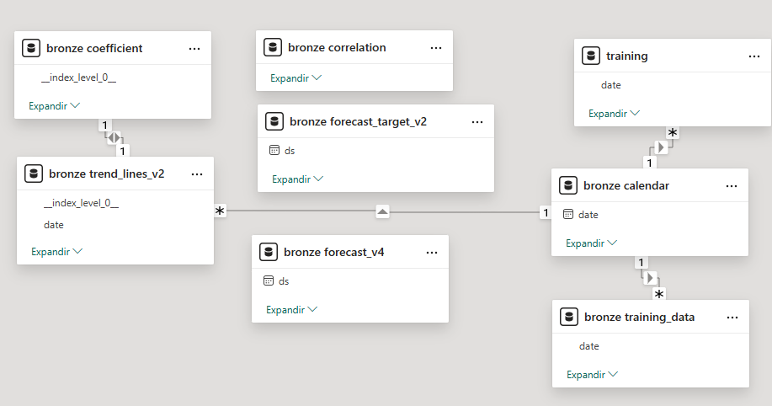
SQL & SQL & Synapse Analytics

